Slide 1
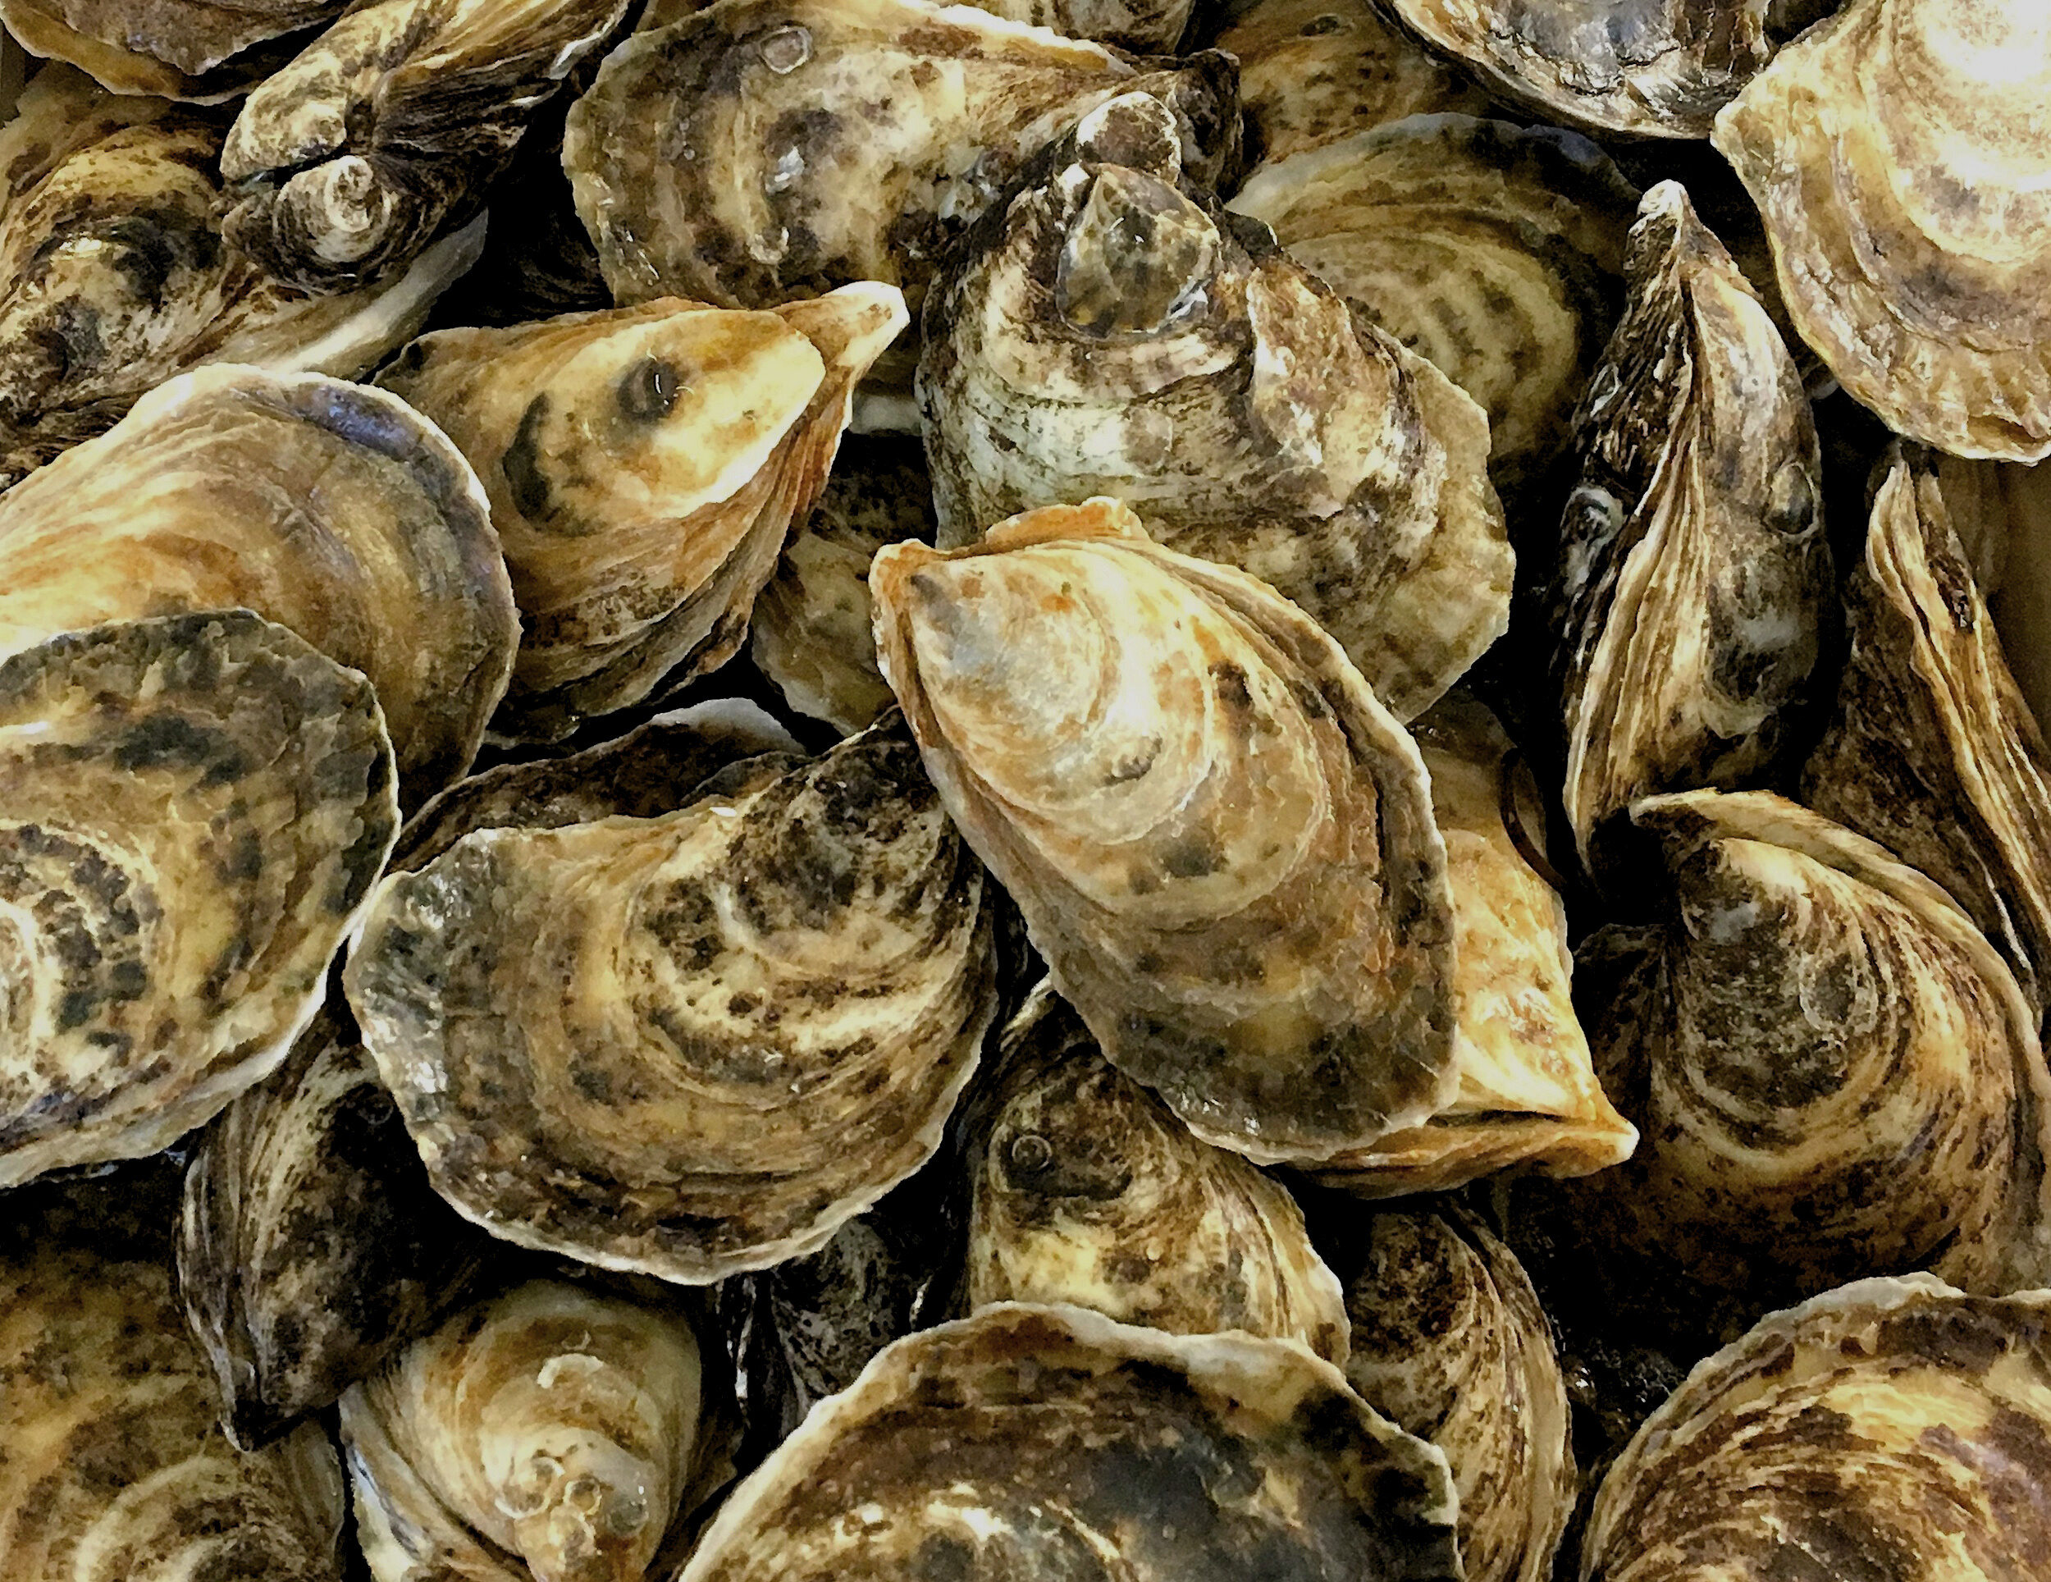
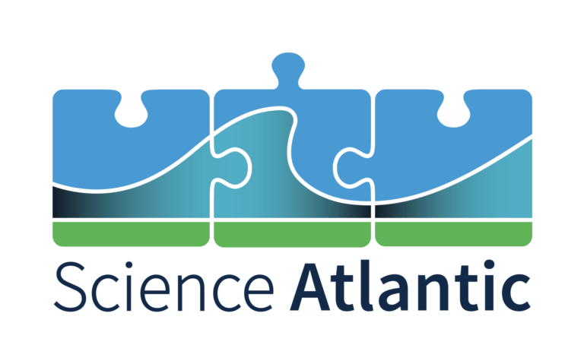

OCTOBER 2025
Oyster MSX
Pipeline
A Human-in-the-Loop System for Accelerating MSX Diagnosis in Oyster Histology
BY JONATHAN E. ZUL LUNA
Mentors:
Dr. Kristina Kupferschmidt, Dr. Andrew Godbout, Dr. David Groman
Notes:
Good morning. My name is Jonathan Zul Luna, and I'm a 4th year Computer Science student at UPEI.
[Pause. Gesture to the image of oysters on the slide.]
These are Eastern oysters. And for Prince Edward Island, they're much more than just seafood—they're a crucial part of our economy and coastal identity.
However, this industry is facing a serious threat from a microscopic parasite that causes a disease called MSX.
Today, I will talk about my summer research, where focused on finding a way to help experts diagnose this disease much, much faster.
[Click to next slide]

Slide 2
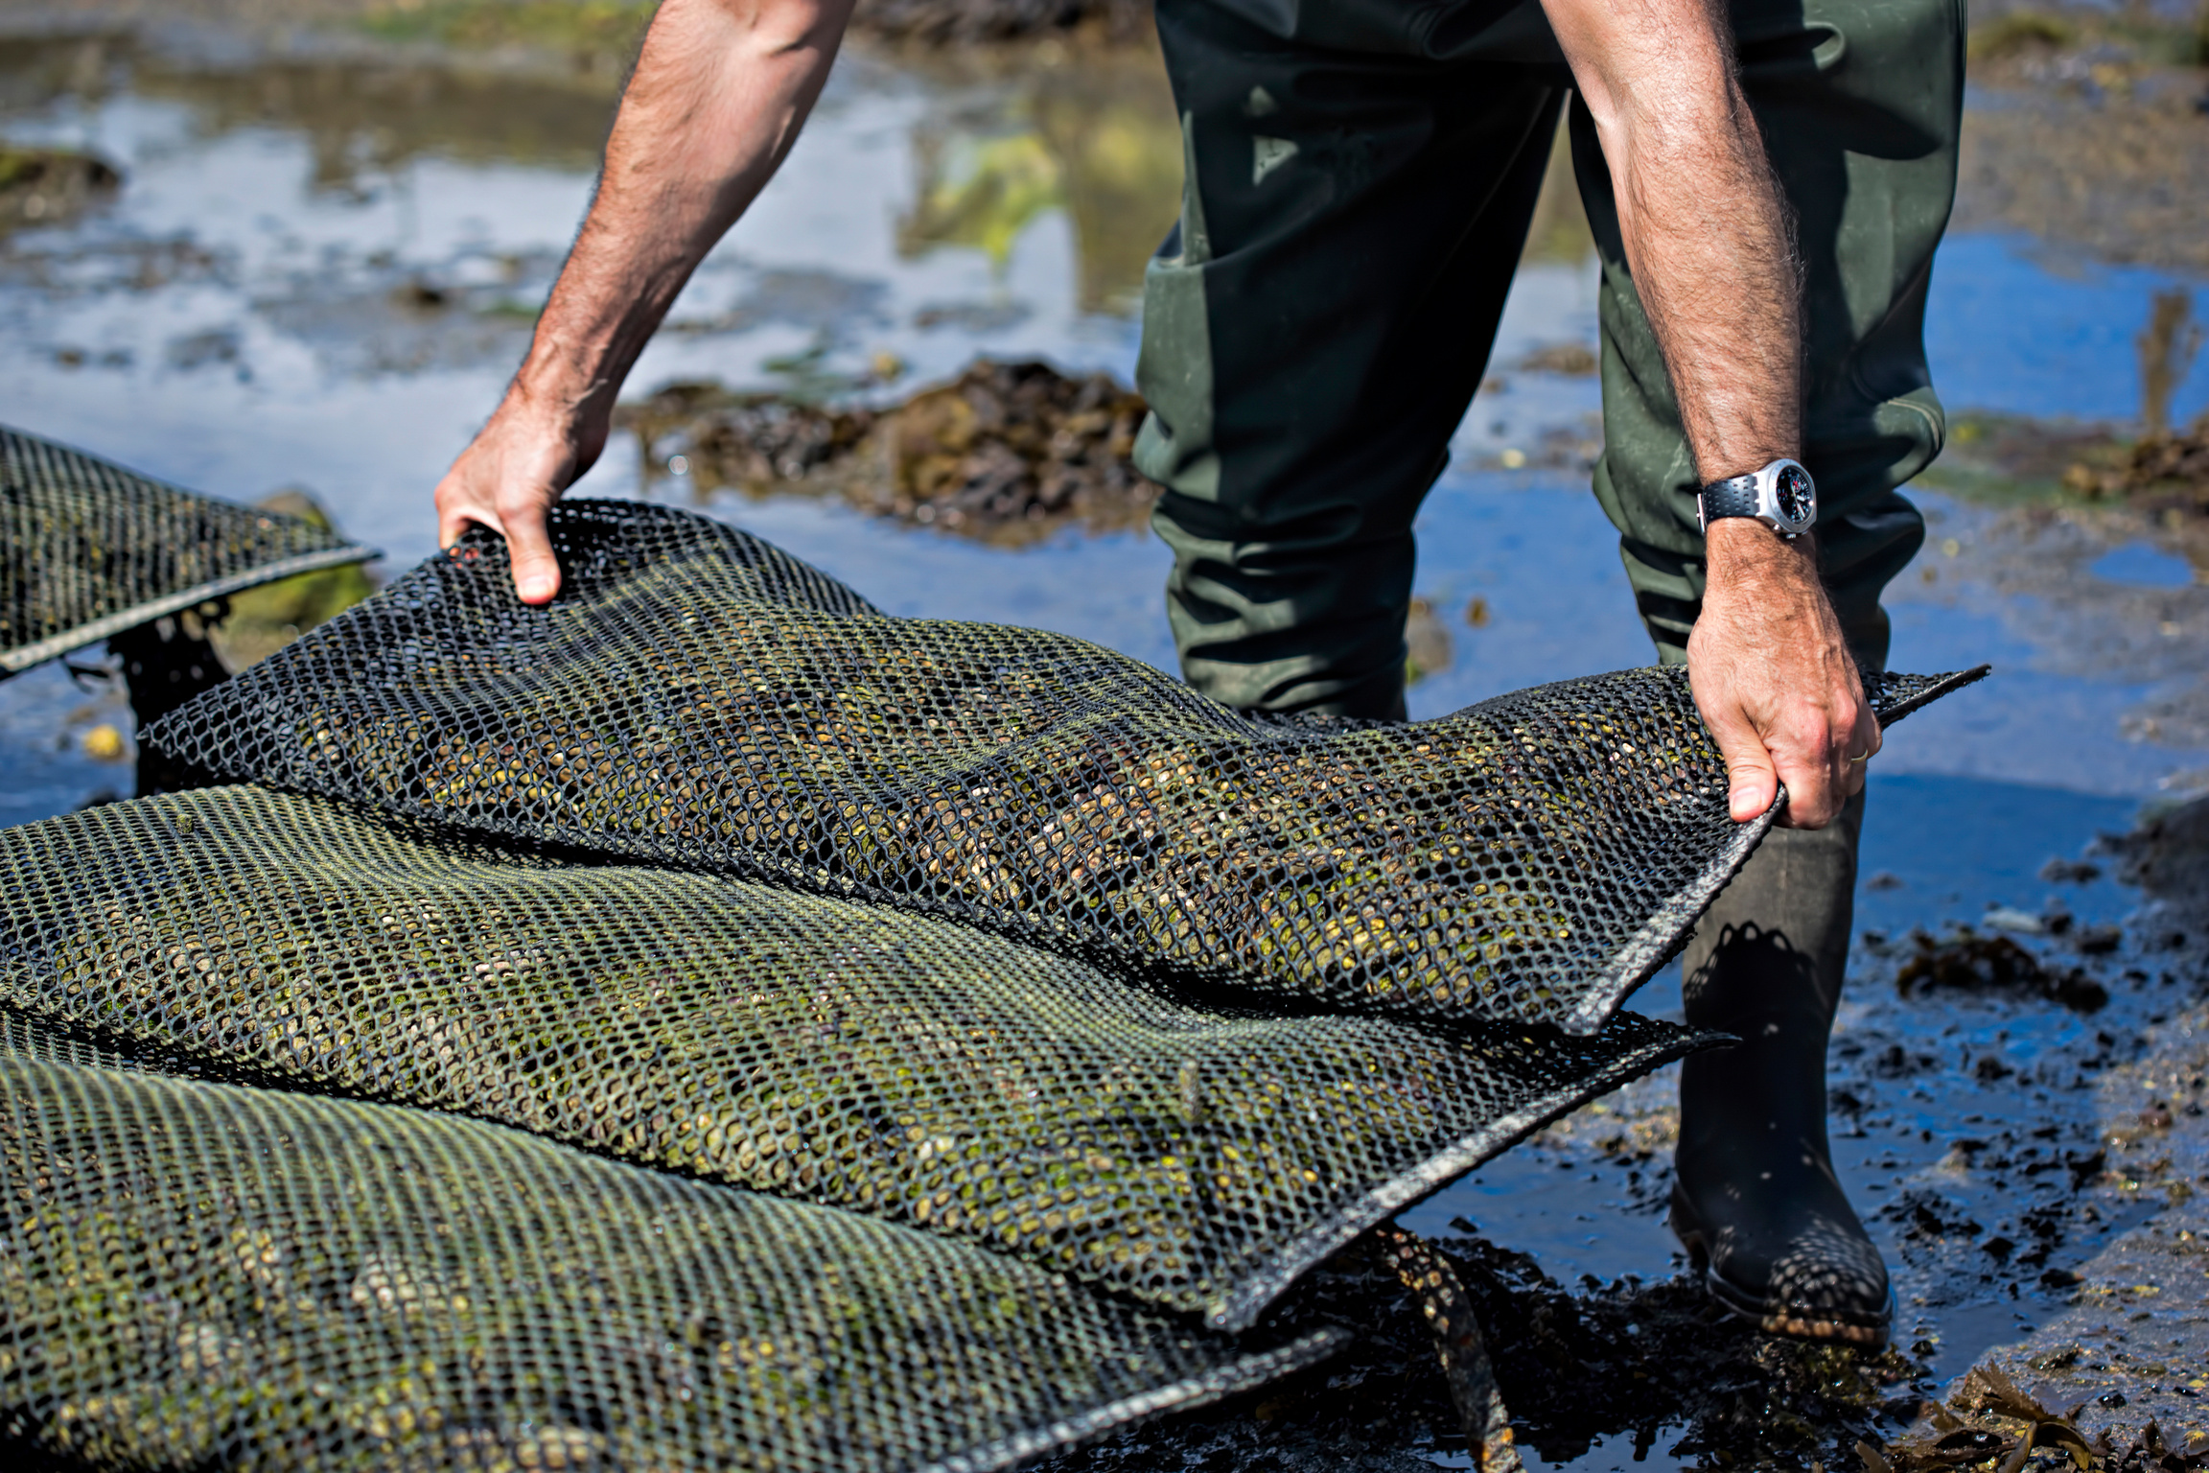
The Economic Engine
PEI’s Oyster Aquaculture Industry
A Key economic driver for the province, valued at over $24 million annually.
Supports hundreds of jobs in rural and coastal communities.
Notes:
But before we talk about the technology, I want to start with why this work is so important for our region.
As I mentioned, in PEI, the oyster industry is woven into our identity.
[Click to show the first bullet point]
Financially speaking, it is a huge economic engine for the province, bringing in over 24 million dollars every year.
[Click to show the second bullet, Gesture to image]
Additionally, it supports hundreds of jobs in the rural and coastal communities that define the island.
[Pause for effect]
So, we have this very important industry... but as I mentioned before, it's in danger. And the threat it is facing is microscopic.
[Click to next slide]

Slide 3
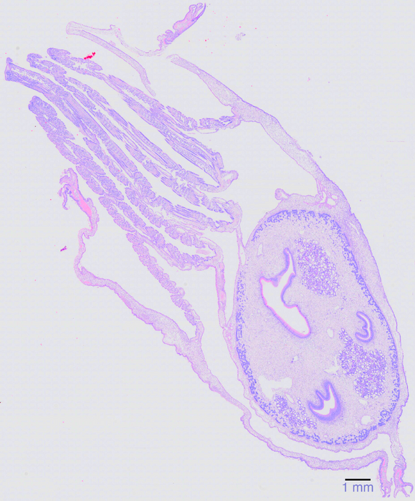
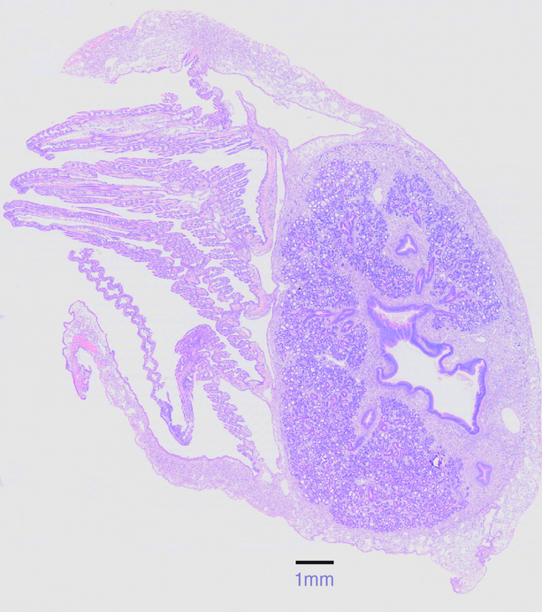
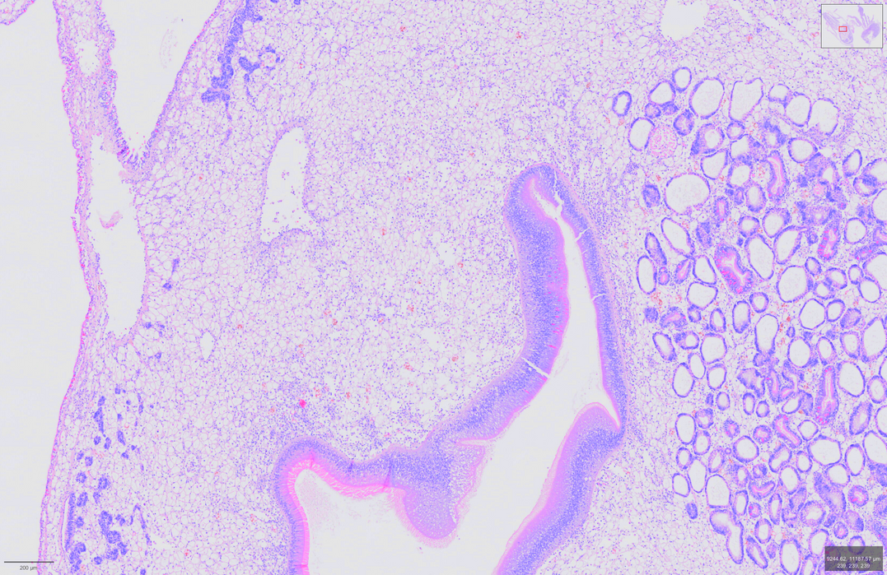
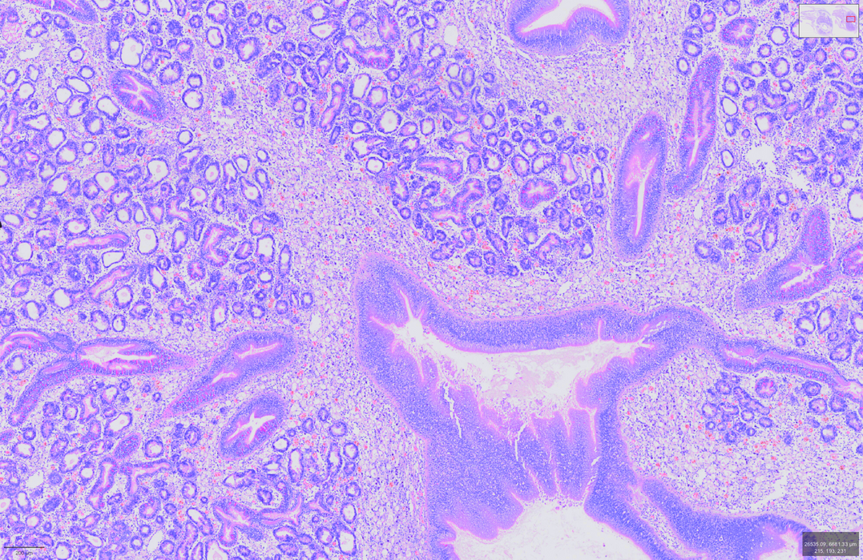
A Microscopic Threat
The MSX Parasite (Haplosporidium Nelsoni)
A protozoan parasite that causes Multinucleated Sphere X (MSX) disease.
Leads to severe tissue damage and high mortality rates in infected oysters.
Early and accurate detection is the only way to manage its spread and protect the industry.
Healthy Oyster Tissue
MSX-Infected Tissue
Notes:
That threat is a parasite called Haplosporidium nelsoni, which causes MSX disease.
The best way to understand the damage it does is simply to see it.
[Click to show healthy oyster]
Here, we have tissue from a healthy oyster. Notice how clean and structured it looks.
[Click to show infected oyster]
Now, look at this tissue on the right.
[Wait 3 seconds]
This is from an oyster with an advanced MSX infection. You can see the difference even if you're not an expert. The infected tissue looks more chaotic, it has a stronger purple color, and the normal structure is breaking down.
But let's take a closer look at what is happening here.
[Click to take images out]
[Click to next slide]

Slide 4
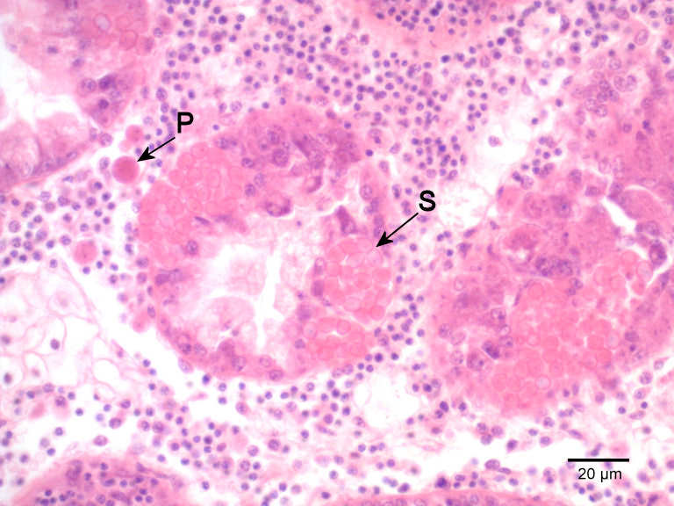
A Microscopic Threat
The MSX Parasite (Haplosporidium Nelsoni)
A protozoan parasite that causes Multinucleated Sphere X (MSX) disease.
Leads to severe tissue damage and high mortality rates in infected oysters.
Early and accurate detection is the only way to manage its spread and protect the industry.
MSX-infected oyster tissue, showing the inflammatory response caused by the disease.
Notes:
Here we have a higher magnification sample of MSX-infected tissue.
The arrows point to the parasite in its different life stages.
But do you see all those small, dark purple dots?
That's the oyster's own immune system swarming the area. This is an intense inflammation response aiming to destroy the parasite. However, it destroys the oyster tissue in the process, killing the oyster instead.
And since there's no cure, our only defense is early and accurate detection before the disease spreads to other oysters.
So, how do we detect it?
[Click to next slide]

Slide 5
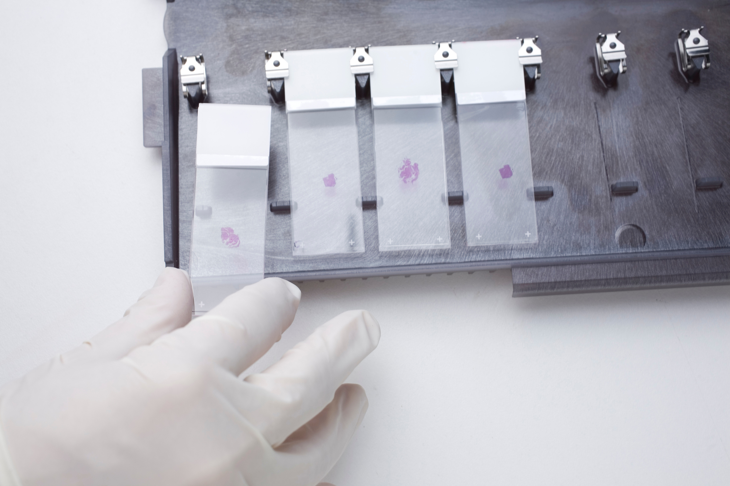
The Diagnostic Front Line
The Role of the Atlantic Veterinary College (AVC)
The AVC is the primary centre for histology-based diagnosis in Atlantic Canada.
Histology is the gold standard for assessing disease severity, unlike other methods (e.g., PCR).
Diagnosis relies on manual slide review by a small number of trained pathologists.
This process is time-consuming, costly, and creates a significant workflow bottleneck.
Notes:
That's all done at the Atlantic Veterinary College, or AVC.
[Click to show first point]
They're the main histology-based diagnosis center in Atlantic Canada.
[Click to show second point]
There are other diagnosis methods like PCR, which can detect a parasite's DNA. That's great for a simple 'yes' or 'no' answer. But to understand how bad an infection really is—to see the actual damage we saw in the last slide—you need histology.
[Click to show third point, gesture to image]
That means having a trained expert look at the tissue under a microscope.
[Click to show fourth point]
The challenge is that this process is entirely manual, and it relies on a very small number of pathologists.
This creates a massive bottleneck. To understand why, let's look at their workflow.
[Click to next slide]

Slide 6
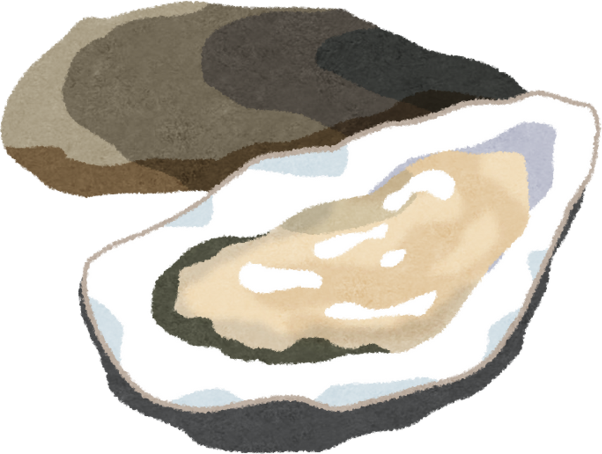

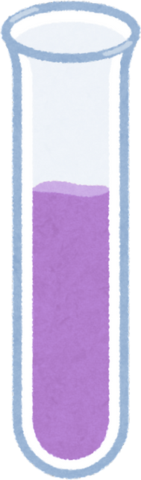
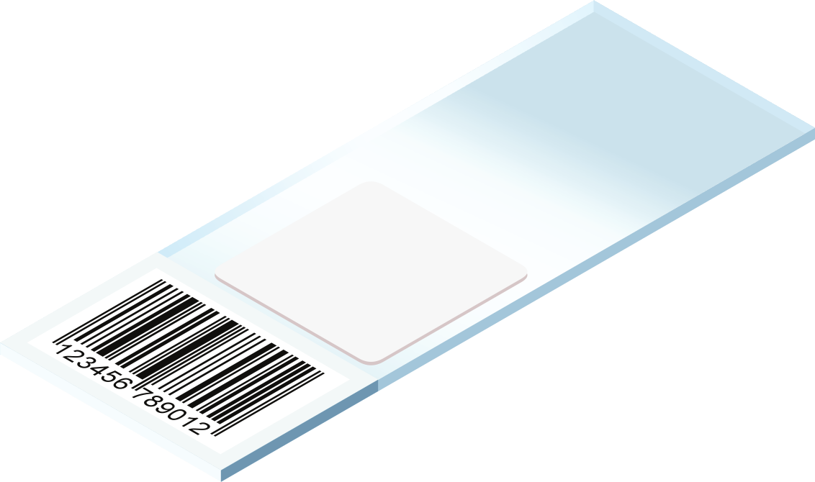
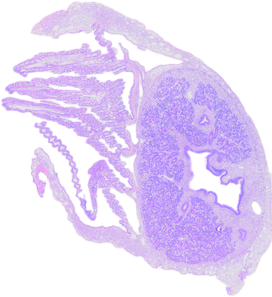
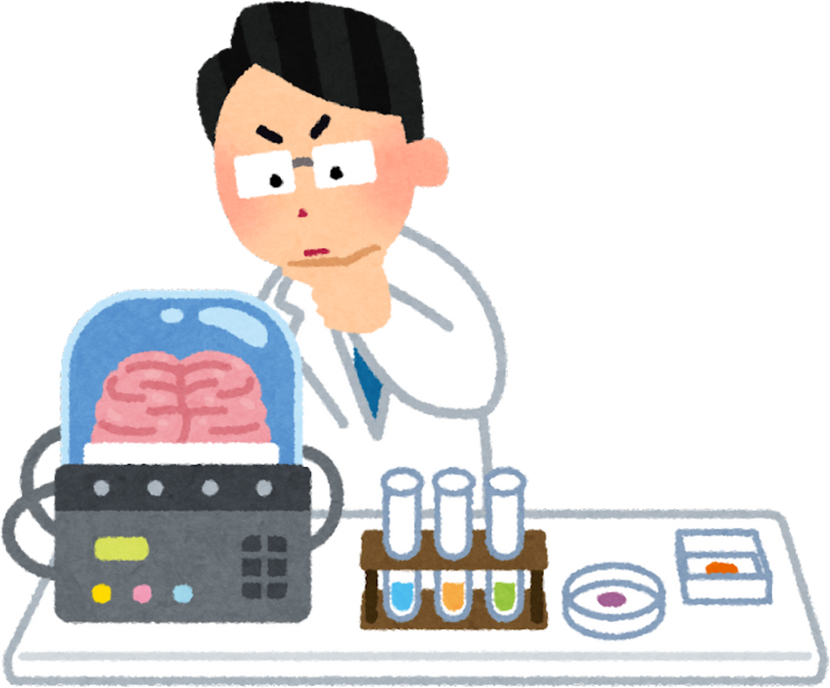
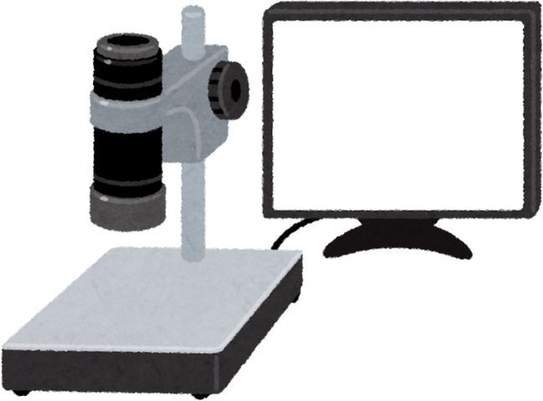

The Histopathology Workflow
The Current Manual Workflow
Time-intensive, requires training, creates bottleneck.
Oyster Collection
Slide Preparation
Manual Review by Pathologist
Notes:
[Click to show Oyster icon]
The process starts with oyster collection.
[Click to show Slicing icon]
Then comes the intensive lab work. Here, an expert takes a thin slice of the entire oyster tissue. And then, they stain this sample and fix it onto a slide.
[Click to show Expert icon]
And all of that work takes us to this final step, where a trained pathologist sits at a microscope and manually scans these enormous, gigapixel-sized images. They're looking for a microscopic needle in a haystack.
[Click to show description]
As you can imagine, this entire process is slow, it's expensive, and because there's only a handful of experts, it's a huge bottleneck. So that's what we are trying to improve.
[Click to next slide]

Slide 7
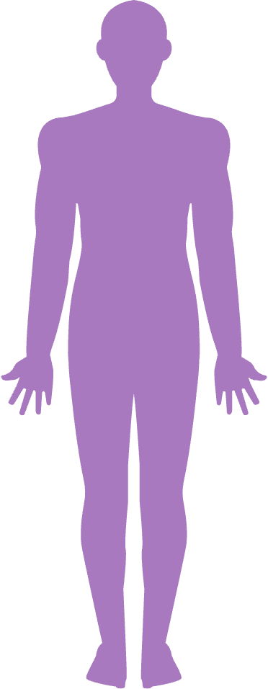
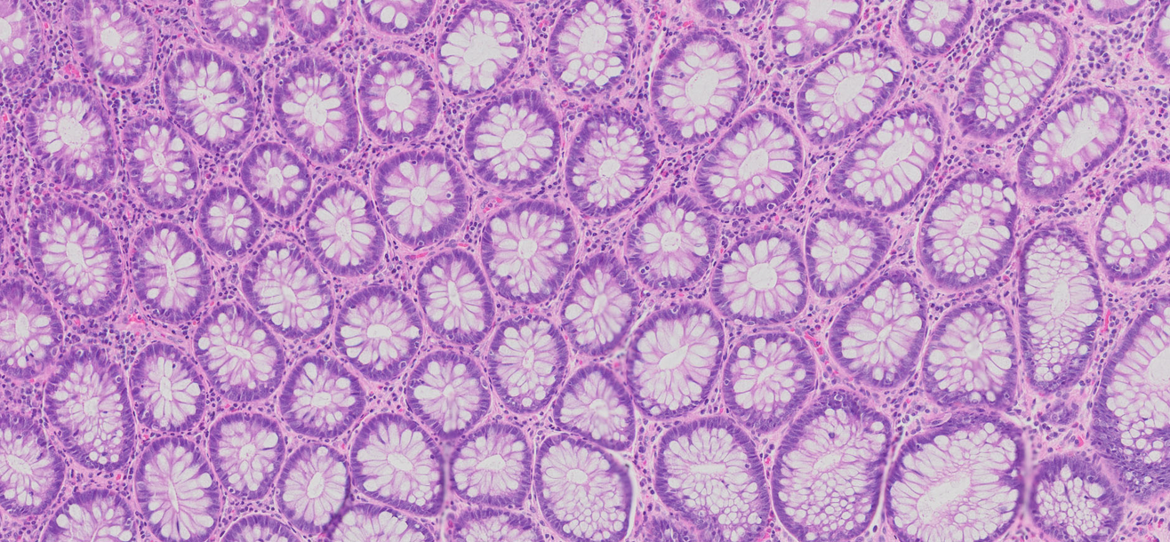
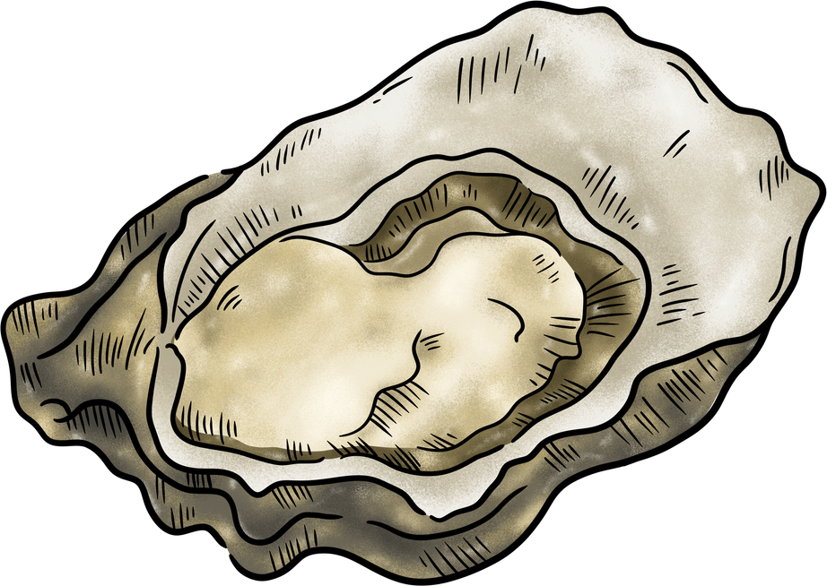

A Fundamental Domain Shift
Why Medical AI Models Fail
Human Colon Tissue
Oyster Tissue
Medical AI learns from small tissue biopsies. Our project analyzes a whole organism cross-section.
Notes:
So the obvious question as someone in Computer Science is, 'Why not just use an existing AI to help? There must be some available model that can do just that!' Well, the reason we can't do that is due to something called a 'domain shift.’
[Click to show Human graphic]
Most medical AI is trained on images like this—a human tissue biopsy. It looks for patterns in a very small and uniform sample of a specific part of the human body, like an organ.
[Click to show Oyster graphic]
But our data is a cross-section of an entire oyster. We have all the organs and distinct regions in the same sample. We have the gills, the digestive system, the mantle—a dozen different tissue types all mixed together in one complex image.
[Pause]
A model trained on a small, uniform sample will not perform as well on this scenario.
So, the conclusion was clear: we had to build our own solution from the ground up.
[Click to next slide]

Slide 8




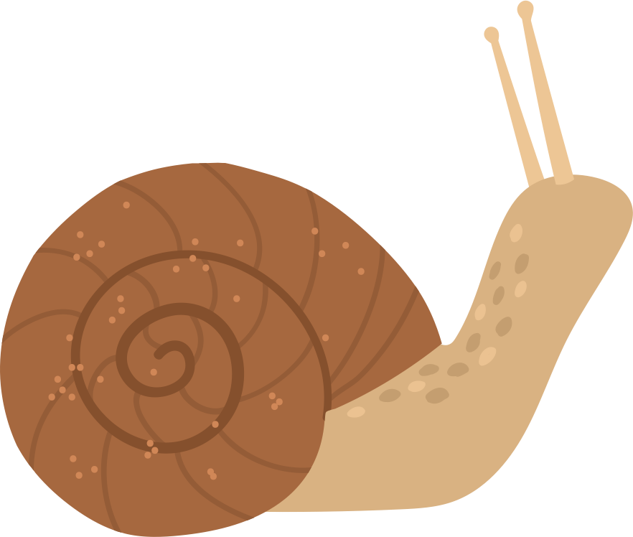
The Data Challenge
Building a High-Quality Dataset from Scratch
The Paradox: To build a tool that saves expert time, we first need a large investment of that same limited expert time.
Notes:
The first step for every ML project is to analyze our data.
[Click to show No Data graphic]
However, in our case, it didn't exist.
[Click to show Expert graphic]
We had to create our own 'ground truth' by asking those same busy pathologists to spend hundreds of hours manually outlining parasites slide after slide.
This created a paradox: to build a tool that saves expert time, we first need to use a lot of their time.
So, we focused on breaking that cycle.
[Click to next slide]

Slide 9
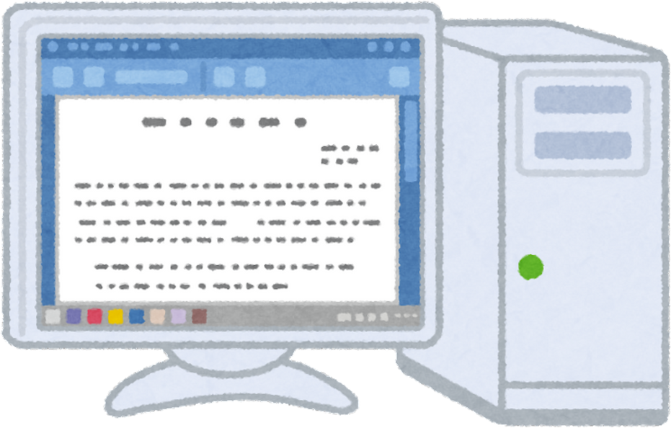


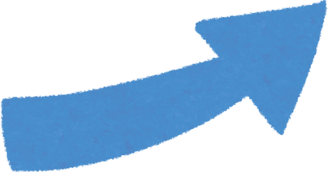


Stage 1:
AI Pre-Analysis
The Strategy
A Human-in-the-Loop Workflow for Pathology
The pipeline performs a first-pass analysis, generating initial annotations on a new slide.
Stage 3:
Model Retraining
Stage 2:
Expert Review
The validated annotations are used to improve the AI model, making it smarter with each cycle.
A pathologist quickly validates and corrects the AI's suggestions, saving valuable time.
Notes:
Our approach is a strategy called Human-in-the-Loop.
Instead of building an AI in isolation, we create a 'virtuous cycle' between the expert and the machine.
[Click to show Step 1 graphic]
First, our automated pipeline performs a pre-analysis on a new slide, generating a set of initial annotations and flagging potential areas of interest.
[Click to show Step 2 graphic]
Next, these suggestions are sent for expert review. This is where the time-saving happens. Instead of searching a massive, blank slide, the pathologist can just validate and make small corrections to the AI's guesses.
[Click to show Step 3 graphic]
And lastly, their corrections are used to retrain the model. So, with every slide, the AI gets smarter.
This cycle solves our data paradox. It helps us build a large, high-quality dataset faster, saving expert time.
[Click to next slide]

Slide 10
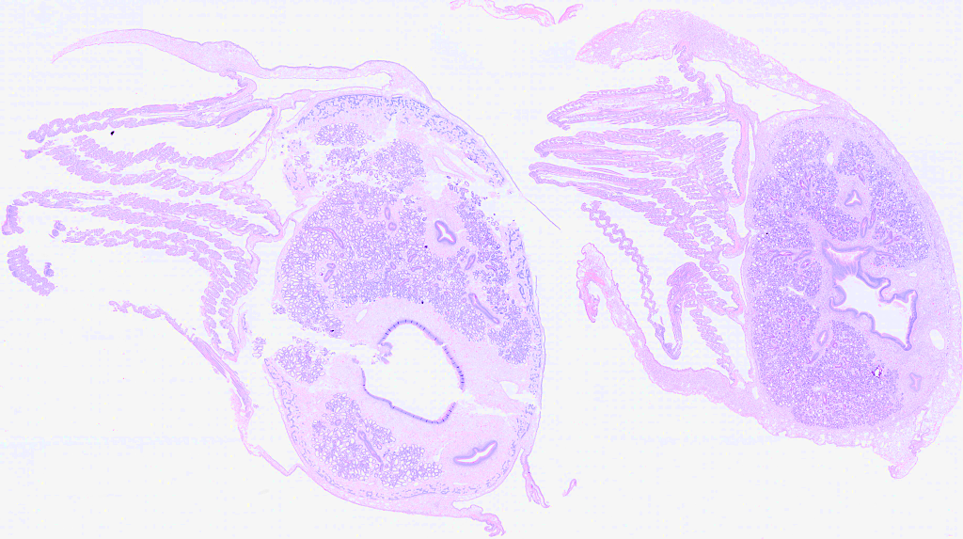
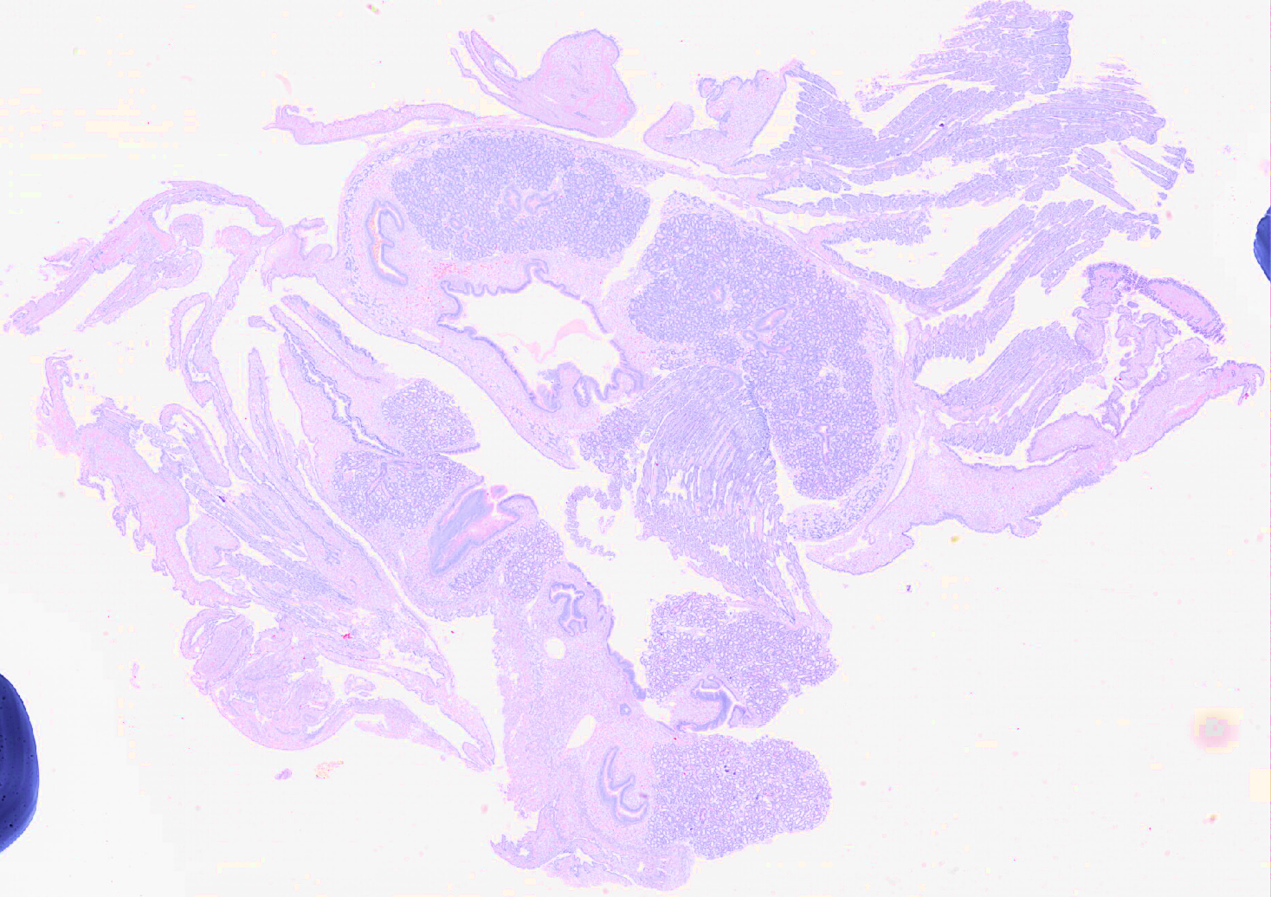
The First Hurdle
Challenge: How can we create a single, automated process that works reliably for both of these cases without manual intervention?
Robustly Separating Oyster Sections
The Ideal Case
The Common Reality
?
?
?
1
?
?
2
Notes:
So, to make that Human-in-the-Loop strategy a reality, I created a complete, automated pipeline. However, we found a challenge along the way.
[Click to show Description]
Before we can even look for a parasite, we have to solve a much more basic problem: figuring out which tissue belongs to which oyster.
Now, you are probably wondering what I mean by this. Well, most of the oyster slides available at the AVC contain more than a single oyster. This cuts costs and improves efficiency. However, this is what creates our challenge.
[Click to show Ideal Case image]
Sometimes, you get a perfect slide like this. The sections are well-defined and clean. Writing code to handle this is easy.
[Click to show Common Reality image]
But the reality is usually much messier. Because the slides are prepared by hand, as we saw previously, we often get tissues that are fragmented, overlapping, or touching. A simple approach that works for the ideal case will fail completely here.
We need a robust approach that can outline each oyster separately, performing well even in tough cases.
[Click to next slide]

Slide 11
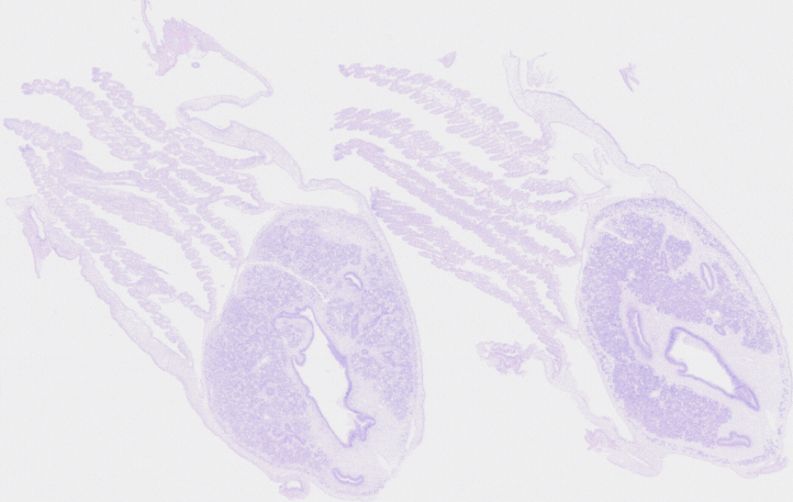
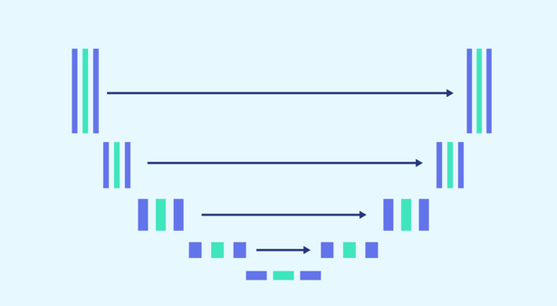
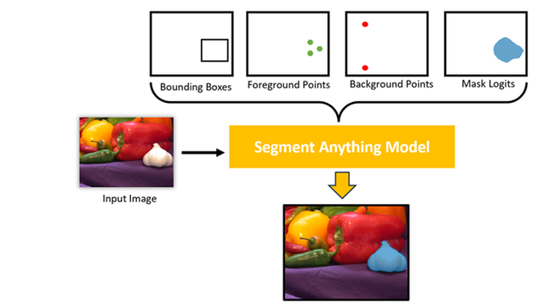
Systematic Investigation
Goal: To find a robust, automated method that best replicates expert annotations.
Classical CV
Supervised ML
Foundation Model
Classical CV
Method: Adaptive Thresholding & Watershed Algorithm.
Goal: Find a rule-based solution.
Method: Train a U-Net model on 30 annotated slides.
Goal: Test a standard, data-driven approach.
Method: Use a massive,
pre-trained general model (SAM) guided by simple prompts.
Goal: Leverage a SOTA general model to overcome data limitations.
Notes:
I tested three different approaches, representing three different eras of computer vision.
[Click to show 'Classical CV' column]
First, I tried a 'classical' computer vision approach: an algorithm that uses things like color, contrast, and brightness to try and define the boundary of the oyster.
[Gesture to the 'Supervised ML' column]
Second, I tested the standard, modern machine learning approach. This is where we take a model called a U-Net and train it from scratch on our 30 annotated slides. It learns by example, like a student studying for a test.
[Click to show the 'Foundation Model' column]
And third, I tried a cutting-edge approach using a 'foundation model.' This uses the massive, pre-trained Segment Anything Model from Meta AI. Instead of teaching a student from scratch with a few dozen examples, we're taking an expert who has studied billions of general images, and we're just giving them simple instructions—or 'prompts'—to guide them.
So we have the rule-based method, the 'study-from-scratch' method, and the 'guide-the-expert' method.
How did they perform?
[Click to next slide]

Slide 12
Key Findings & The Winning Approach
Approach | Methodology | Key Finding | Avg. Dice Score
Classical CV | Thresholding & Watershed | Brittle & Parameter-Sensitive. Fails on complex slides and requires constant manual tuning. | 0.7463 ± 0.1287
U-Net | Supervised Deep Learning | Data-Starved. The dataset is too small (60 oysters), leading to poor generalization. | 0.3801 ± 0.1104
SAM | Promptable Foundation Model | Most Robust & Data-Efficient. Intelligently handles fragmentation and leverages pre-trained knowledge. | 0.8846 ±0.0600
Notes:
To compare them, we use a metric called the Dice Score.
[Click to bring up the Dice Score explanation overlay]

Slide 13
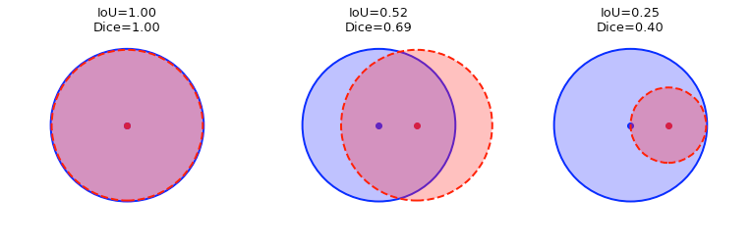
Key Findings & The Winning Approach
Visual of Dice Score
Approach | Methodology | Key Finding | Avg. Dice Score
Classical CV | Thresholding & Watershed | Brittle & Parameter-Sensitive. Fails on complex slides and requires constant manual tuning. | 0.7463 ± 0.1287
U-Net | Supervised Deep Learning | Severely Overfit. The model was data-starved by the small dataset, leading to poor generalization. | 0.3801 ± 0.1104
SAM | Promptable Foundation Model | Most Robust & Data-Efficient. Intelligently handles fragmentation and leverages pre-trained knowledge. | 0.8846 ±0.0600
Dice = 1.0
Dice = 0.70
Dice = 0.40
Ground Truth
Prediction
Notes:
The idea is very simple. The Dice Score just measures the amount of overlap between the expert's annotation and our model's prediction of the oyster outline.
If they match perfectly, the Dice Score is 1. If the overlap is pretty good, you get a high score like 0.7. If it's a poor match, you get a low score.
Basically, the closer the score is to 1, the better our model is at replicating the expert's work.
[Click to hide the overlay and return to the main table]

Slide 14

Key Findings & The Winning Approach
Approach | Methodology | Key Finding | Avg. Dice Score
Classical CV | Thresholding & Watershed | Brittle & Parameter-Sensitive. Fails on complex slides and requires constant manual tuning. | 0.7463 ± 0.1287
U-Net | Supervised Deep Learning | Data Starved. The model was limited by the small dataset, leading to poor generalization. | 0.3801 ± 0.1104
SAM | Promptable Foundation Model | Most Robust & Data-Efficient. Intelligently handles fragmentation and leverages pre-trained knowledge. | 0.8846 ±0.0600
Notes:
Alright, so with that in mind, let's look at the results.
The classical method gave us a decent baseline of .75, but it was brittle and needed constant manual tuning.
The U-Net completely failed, with a score of .38. This was a great finding, because it proved the standard approach isn't viable here. The model is limited by our small segmentation dataset, which contains only 60 oysters.
[Pause, then click to show Prize icon]
That left the foundation model, SAM, as the winner with a Dice Score of .88. This proved to be a robust and data efficient approach. So that's the one we implemented in our HIL pipeline.
[Click to next slide]

Slide 15
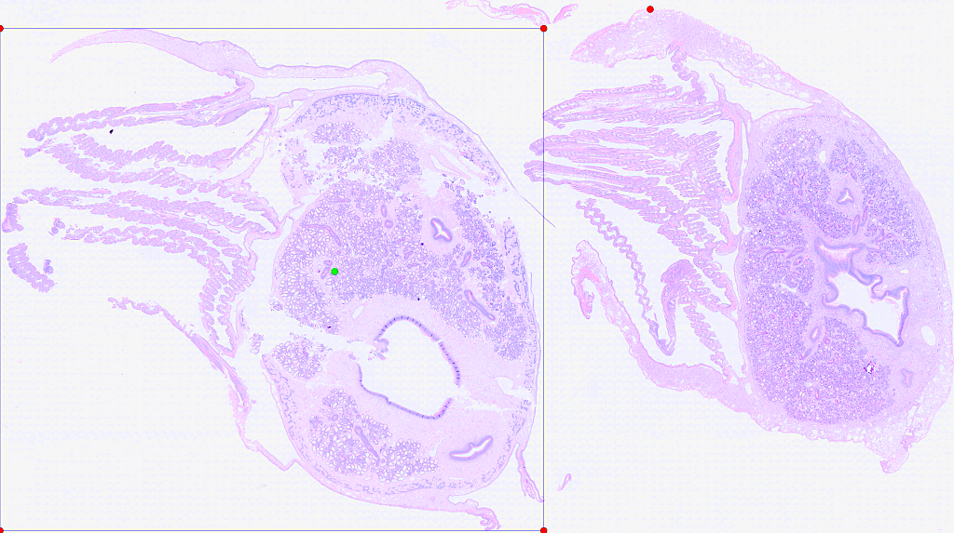
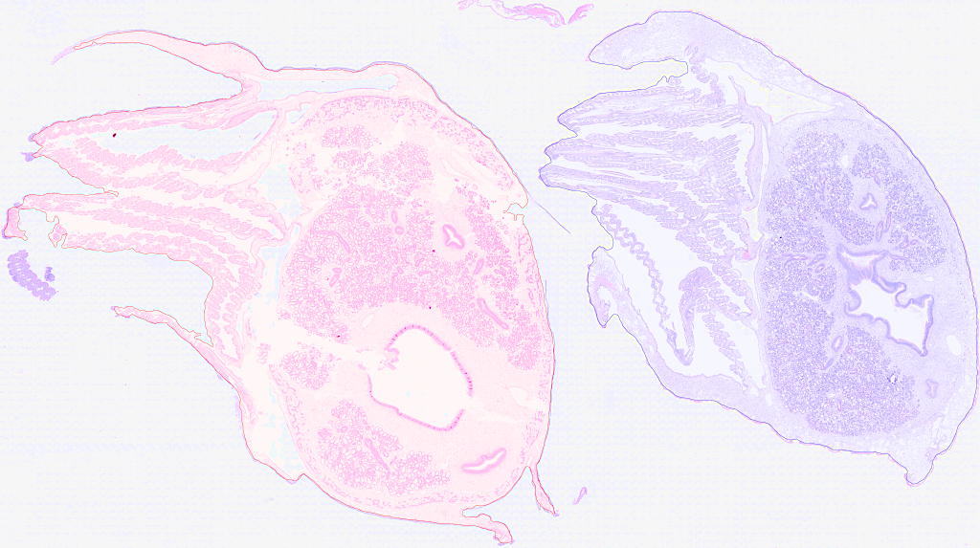
The Solution
This hybrid strategy uses a simple, reliable method to answer 'where,' and the powerful foundation model to answer 'what.'
A Hybrid Pipeline for Intelligent Prompting
Step 1: Generate Robust Prompts (CV)
Step 2: Precise Segmentation (SAM)
Notes:
So, how does this approach work?
This is a hybrid pipeline.
[Click to show Step 1 image]
Step one answers a simple question: 'Where is the tissue?' I wrote a script that quickly scans a low-res version of the slide to find the general location of each oyster. And then it generates a set of simple instructions–or prompts– for the next step.
[Click to show Step 2 image]
Then, in step two, we pass those instructions to the powerful foundation model, SAM, to answer the much harder question: 'What is the exact boundary?'
We’re basically telling it: 'The thing I want you to find is inside this box, it includes the green dot, and it definitely doesn't include the red dots.' And because SAM has seen billions of images, it's really good at following these simple directions to produce a precise outline.

Slide 16
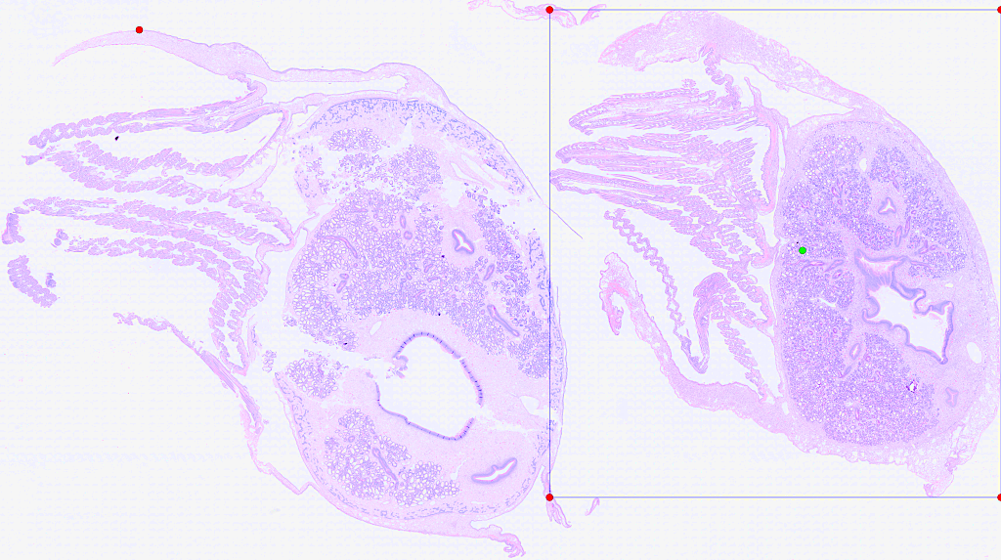
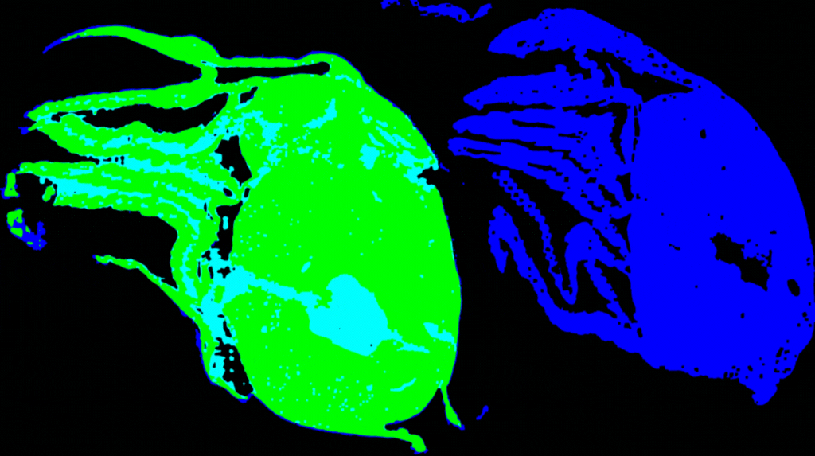

The Solution
This hybrid strategy uses a simple, reliable method to answer 'where,' and the powerful foundation model to answer 'what.'
A Hybrid Pipeline for Intelligent Prompting
SAM’s Guess
Expert Annotation
Step 1: Generate Robust Prompts (CV)
Step 2: Precise Segmentation (SAM)
Notes:
Here’s a direct comparison. In blue is the expert’s ground truth, and in green is our solution's output. We can see the overlap is excellent.
To put a number on that, let's look at the final metrics.
[Click to next slide]

Slide 17
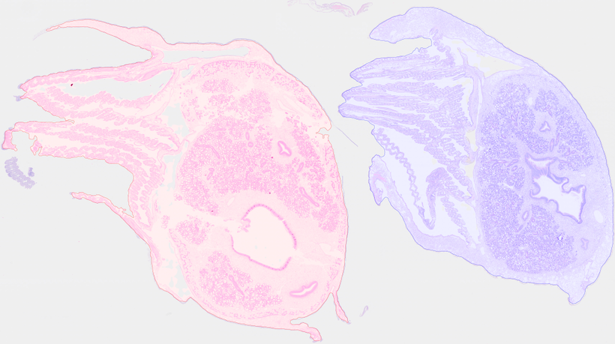
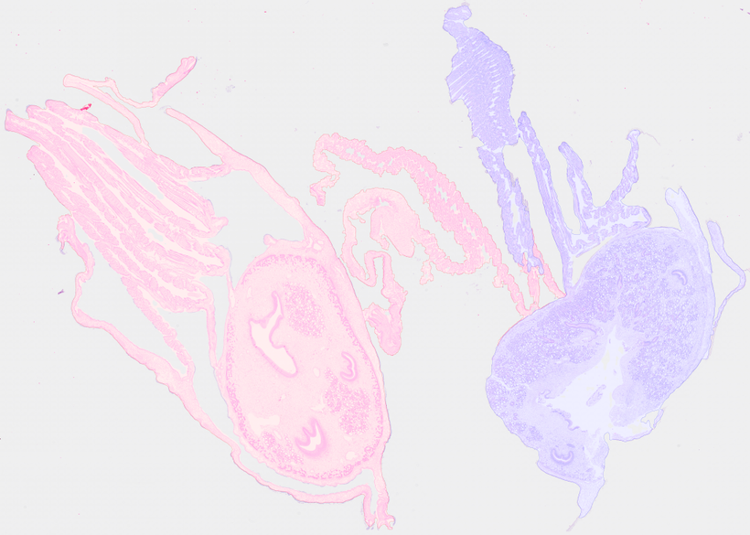
Performance Analysis: Quantitative & Qualitative Results
Quantitative Results (Avg. Across 30 Slides)
Qualitative Results
Metric | Score | Interpretation
Dice Score | 0.8846 ±0.0600 | Strong overlap; good proxy for boundary accuracy.
IoU (Jaccard) | 0.8211 ± 0.0776 | Good area-based overlap.
J&F Score | 0.8528 ± 0.0685 | Strong overall score, comparable to benchmarks.
Success Case: Clean separation and tight boundaries on a well-defined slide.
Challenging Case: The model struggles when oysters are intertwined, showing the limits of the current prompter.
Notes:
Here's the final report card.
[Click to show Quantitative results]
Quantitatively, the results are excellent, with an average Dice Score of almost point-eight-nine. This is a strong, reliable result.
[Click to show Qualitative title]
But the pictures tell the story even better.
[Click to show Success Case]
On a typical, clean slide, you can see the result is nearly perfect. We get clean separation and tight boundaries.
[Click to show Challenging Case]
But just as importantly, we can see the system's limits. Our simple prompter step struggles on some cases. This isn't a failure of SAM, but it gives us an idea of what to improve next.
[Click to next slide]

Slide 18
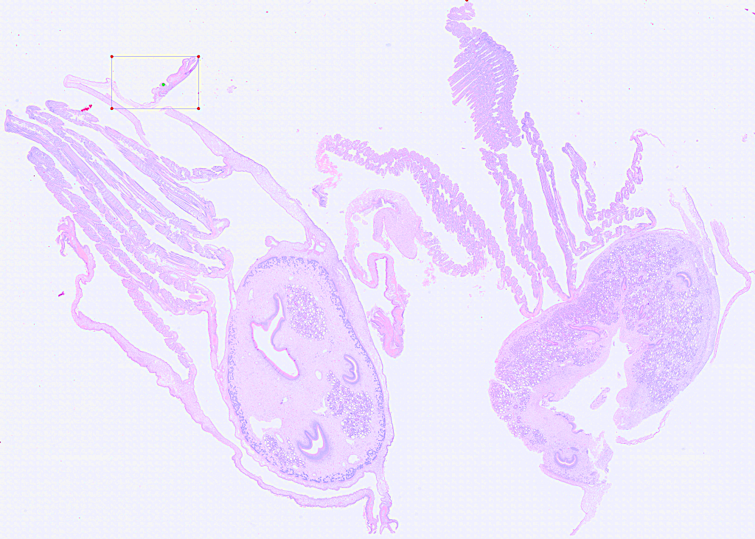

Current Limitations & Diagnosis
Brittle Prompt Generation
Small Dataset Size
30
Slides
(32,000+ Patches/slide)*
The current CV-based prompter is the weakest link and can fail on complex slides.
While 30 slides generate hundreds of thousands of training patches, they don't capture the full range of biological variability needed for a production-ready model.
These limitations are not roadblocks; they are a clear and actionable guide for what to do next.
Notes:
We have two clear limitations.
[Click to show First Limitation]
First is that simple prompter—it’s what makes our segmentation solution struggle on the toughest slides.
[Click to show Second Limitation]
The second limitation, focused more on the MSX Detection part, is the dataset size. 30 slides are more than enough to prove that our hybrid approach works, as each slide can be used to generate thousands of patches for training. However, it's not enough to capture the huge biological variety you'd see in the real world. To build a truly robust, production-ready parasite detector, we'll need more data.
[Pause, click to show bottom text]
But these aren't roadblocks; they are guides for our next steps.
[Click to next slide]

Slide 19
The Path Forward: A Phased Plan
Medium-Term
Long-Term
Large-Scale Data Annotation
(Next 1-2 Months)
Train the Production MSX Detector
Objective: Expand the dataset to capture the full range of biological and technical variability.
Action: Utilize the complete HIL pipeline. Use our robust SAM segmenter to pre-annotate 50-100+ new slides for rapid expert validation.
Objective: Fulfill the project's primary mission of accelerating MSX diagnosis.
Action: With the segmentation problem solved and a large dataset in place, proceed with training a high-performance YOLO-based MSX detector.
Notes:
We have a clear, two-phase plan.
[Click to show the 'Medium-Term' column]
So, our Human-In-The-Loop pipeline is complete. Now, in the next couple of months, we'll use it to rapidly pre-annotate hundreds of new slides.
[Click to show the 'Long-Term' column]
Them, with a larger dataset, we can then achieve our main goal: building a trusted and validated tool that helps pathologists diagnose this disease much faster.
[Pause, then click to the final slide]

Slide 20
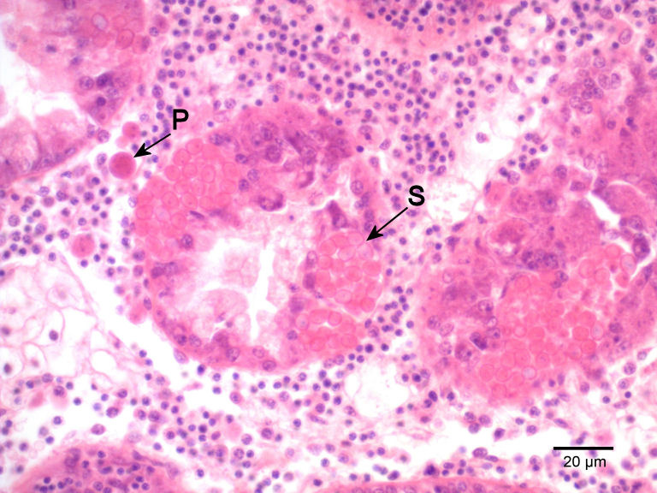
Conclusion & Questions
Built a Complete HIL Pipeline
Successfully engineered and validated a complete, end-to-end Human-in-the-Loop pipeline for processing oyster histology slides.
Solved the Segmentation Challenge
Systematically investigated multiple methods and proved that a hybrid SAM-based approach is the most effective solution for the critical oyster segmentation task.
Established a Clear Path to Success
Have established a strong baseline performance, diagnosed the current limitations, and defined a clear, data-driven, three-phase plan for developing a production-ready MSX detection model.
Notes:
So, to wrap up:
[Pause, then click to show First Point]
This summer, we took this project from an idea to a fully engineered pipeline.
[Click to show Second Point]
We solved the segmentation challenge with a data-driven approach.
[Click to show First Point]
And lastly, we've turned our results into a clear plan for what comes next.
At the end of the day, this work lays the foundation for a tool that can help protect one of our region's most important industries.
Thank you. I'd be happy to answer any questions.

Slide 21

AUGUST 2025
Thank
You
BY JONATHAN E. ZUL LUNA
Notes:
I'd like to quickly thank my mentors, Dr. Kupferschmidt, Dr. Godbout, and Dr. Groman, for their guidance throughout this project.
I would now be happy to answer any questions you may have.
WHAT DID YOU DO TO TRY TO IMPROVE UNET? ENCODER, FREEZING,

